Slide 1
Easier BEACON: Making Automated Fuzzing Simpler
Improvements to BEACON, a directed greybox fuzzer
Patrick Elser
Sidharth Krishna

Slide 2
Presentation
overview
Overview of BEACON
Problems in BEACON
Our Solutions
Implementation So Far

Slide 3
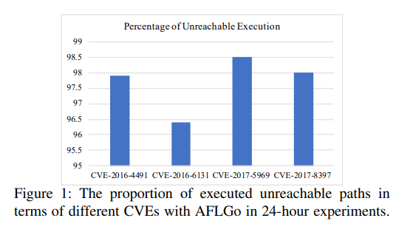
Paper: BEACON : Directed Grey-Box Fuzzing with Provable Path Pruning
IEEE S&P 2022
Overview: Directed grey-box fuzzers aim to efficiently test specific program locations but often suffer from the infeasible-path explosion problem. BEACON addresses this by pruning infeasible paths early, dramatically improving fuzzing efficiency.
Notes:
-program locations ex. (e.g., patches or vulnerable code) -infeasible-path explosion problem—executing paths that can never reach the target. -Directed grey box fuzzing is a widely adopted method but all current ones lack efficiency because of the problem above. -more than 95% of the inputs cannot reach the given program point in the 24-hour experiment mentioned in AFLGo

Slide 4
Why directed fuzzing?
Only fuzz newly added code.
Reproduce past crashes.
Focus on risky or sensitive functionality.
Reduce time and cost.

Slide 5
What's different about BEACON?
BEACON combines static analysis and selective runtime instrumentation to prune infeasible paths. Using lightweight static analysis, BEACON computes sound approximations of variable values that make a path infeasible.
Example: To reach Line 8 (target), w > 10 must hold at Line 7. If, at the start of the function, x is between 5 and 25, the condition cannot be met, regardless of the value of y.
1 void foo(int x, int y) {
ASSERT(x<=5 || x>=25) //Oracle
2 if (y > 10) {
3 x = x-15;
4 } else {
5 x = -x+15;
6 }
7 if (x>10) {
8 crash();
9 }
10 }

Slide 6
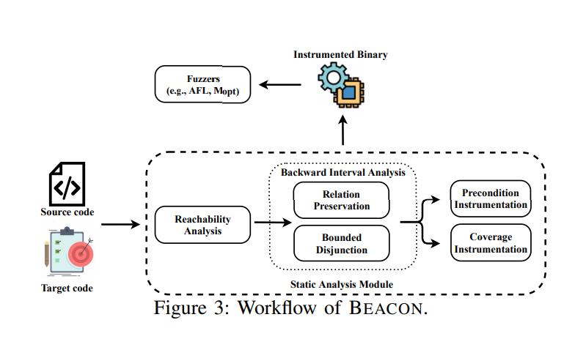
BEACON’s workflow
Reachability Analysis: Remove paths that cannot reach the target at all.
Backward Interval Analysis: Compute necessary preconditions (wp^) for reaching the target.
Instrumented Fuzzing: Insert assertions to abort infeasible paths early during execution

Slide 7
Backward Interval Analysis
Propagates conditions backwards from the target.
Uses an interval domain to over-approximate possible variable values.
Ensures soundness: any pruned path cannot reach the target.
Example:
Target condition wp(l13, l18) ≡
z < 2y ∧
v < 60 ∧
x < 40 ∧
v = y − x ∧
w > 10
can be approximated as intervals:
w ∈ (10, ∞), x ∈ (-∞, 40), v ∈ (-∞, 60),
y ∈ (-∞,100), z ∈ (-∞,200)
Notes:
interval domain because it is among the cheapest that can be computed via a featherweight static analysis. Can also be easily checked at runtime.

Slide 8
Optimizations
Interval abstraction does not respect inter-variable relationships and merging backward paths leads to imprecise results. Relationship Preservation: Formally, this problem can be described as: given a path condition φ, how to compute the interval of a variable v. Tracks relationships between variables (e.g., v = y − x) to refine intervals.
Avoids imprecise results from conventional interval analysis.
BEACON preserves linear variable relationships, improving precision.
Notes:
interval domain because it is among the cheapest that can be computed via a featherweight static analysis. Can also be easily checked at runtime.

Slide 9
Optimizations
Bounded Disjunction:
Keeps multiple path conditions separately up to a threshold τ.
Comparisons show how:
τ = 1 (classic interval merging) → imprecise (threshold is 1 for conventional method as it always merges).
τ ≥ 2 → precise, but expensive , merges with the least interval overlap.
τ = 5 → BEACON's chosen sweet spot.
Notes:
interval domain because it is among the cheapest that can be computed via a featherweight static analysis. Can also be easily checked at runtime.

Slide 10
CFG Representation
Start
(-∞,5)u(25,∞)
slowFunctionCall()
1 void foo(int x, int y) {
ASSERT(x<=5 || x>=25)//Oracle_
2 slowFunctionCall();
3 if (y > 10) {
4 x = x-15;
5 } else {
6 x = -x+15;
7 }
8 if (x>10) {
9 crash();
10 }
11 }
(-∞,5)u(25,∞)
1 void foo(int x, int y) {
2 slowFunctionCall();
3 if (y > 10) {
4 x = x-15;
5 } else {
6 x = -x+15;
7 }
8 if (x>10) {
9 crash();
10 }
11 }
y > 10
x = x - 15
(25,∞)
(-∞,5)
x = -x + 15
x > 10
(10,∞)
Problem example:the conventional approaches merge static analysis results from different paths. e.g., x in (-infinity, 5) and x in (25, +infinity) from Line 3 and Line 5 , which results in an imprecise result: w in ( -infinity, +infinity).
crash()
end

Slide 11
Optimizations
Selective Instrumentation:
BEACON only instruments:
Variable definitions
Branch decisions
This is where pruning is most effective.
Reduces runtime overhead while pruning infeasible paths effectively.
1 void foo(int x, int y) {
ASSERT(x<=5 || x>=25) //Oracle
2 if (y > 10) {
3 x = x-15;
4 } else {
5 x = -x+15;
6 }
7 if (x>10) {
8 crash();
9 }
ASSERT(false) //Oracle _
10 }
Notes:
ex1:every execution reaching this point with the condition 5 <= x <=25 is aborted immediately after the variable w is defined.
ex2:assert(false), at Line 09 because this block cannot reach the target point through control flow.

Slide 12
Problems
BEACON proposes directed greybox fuzzing for
Validating new code
Reproducing crashes
Testing risky code
However, BEACON is not easy for developers to use
Docker image not documented
Precompiled binaries not available
Selecting target line is tedious and fragile
Requires developers to set up the environment for each instrumentation
Multiple instrumentation steps

Slide 13
Solutions
Integrate BEACON into existing CI/CD infrastructure

Slide 14
What is CI/CD
CI/CD stands for Continuous Integration / Continuous Deployment
Allows for the automated actions with git
Development teams use CI/CD for
Building projects and releases
Packaging code
Linting
Updating production code
Automated Testing
And more!
CI/CD allows for easier, repeatable testing
Focus on Gitlab’s CI/CD pipelines

Slide 15
Gitlab CI/CD
stages:
-build
-test
build-program:
stage: build
image:
name: patrickelser/beacon
entrypoint: [“”]
script:
- /bin/bash /beacon/beacon.sh myFile.c
artifacts:
paths:
- myProgram
- myProgram-ins
fuzz:
stage: test
script:
- echo “TO DO”
Uses a yaml file at the root of the git repo
An example pipeline is shown
Stages are executed in order
Jobs within a stage are executed in parallel
The scripts are run within docker containers
Each container starts with a fresh copy of the repository
Artifacts from earlier stages are carried over
Artifacts can be downloaded from Gitlab separately

Slide 16
Solutions
Integrate BEACON into existing CI/CD infrastructure
Makes usage easier for team members
Performs all steps automatically
Uses technologies many developers are already familiar with
Ensures steps are not skipped

Slide 17
Remaining Problems
BEACON requires two parameters other than source code
Valid AFL fuzzing inputs
The target line number

Slide 18
Remaining Problems
BEACON requires two parameters other than source code
Valid AFL fuzzing inputs
Create a hidden directory at the root of the repo called .fuzzing-inputs
The target line number

Slide 19
Target Line Number Problem
BEACON expects the target line number and file to be provided statically
Target line numbers can change frequently
As patches are applied
As code is reorganized
Upon linting
Statically determining this line number is infeasible

Slide 20
Target Line Number Problem
Mark the target line with a comment
Allows for flexibility as code is moved around
“Set it and forget it”
When BEACON is run, the code is scanned for the specific comment
//?BEACON
Line number and file are noted, and used for the debug process
1 void foo(int x, int y) {
ASSERT(x<=5 || x>=25) //Oracle
2 if (y > 10) {
3 x = x-15;
4 } else {
5 x = -x+15;
6 }
7 if (x>10) {
8 crash(); //?BEACON
9 }
10 }

Slide 21
Contribution
Our contributions so far
Make a docker container with BEACON and necessary tools

Slide 22
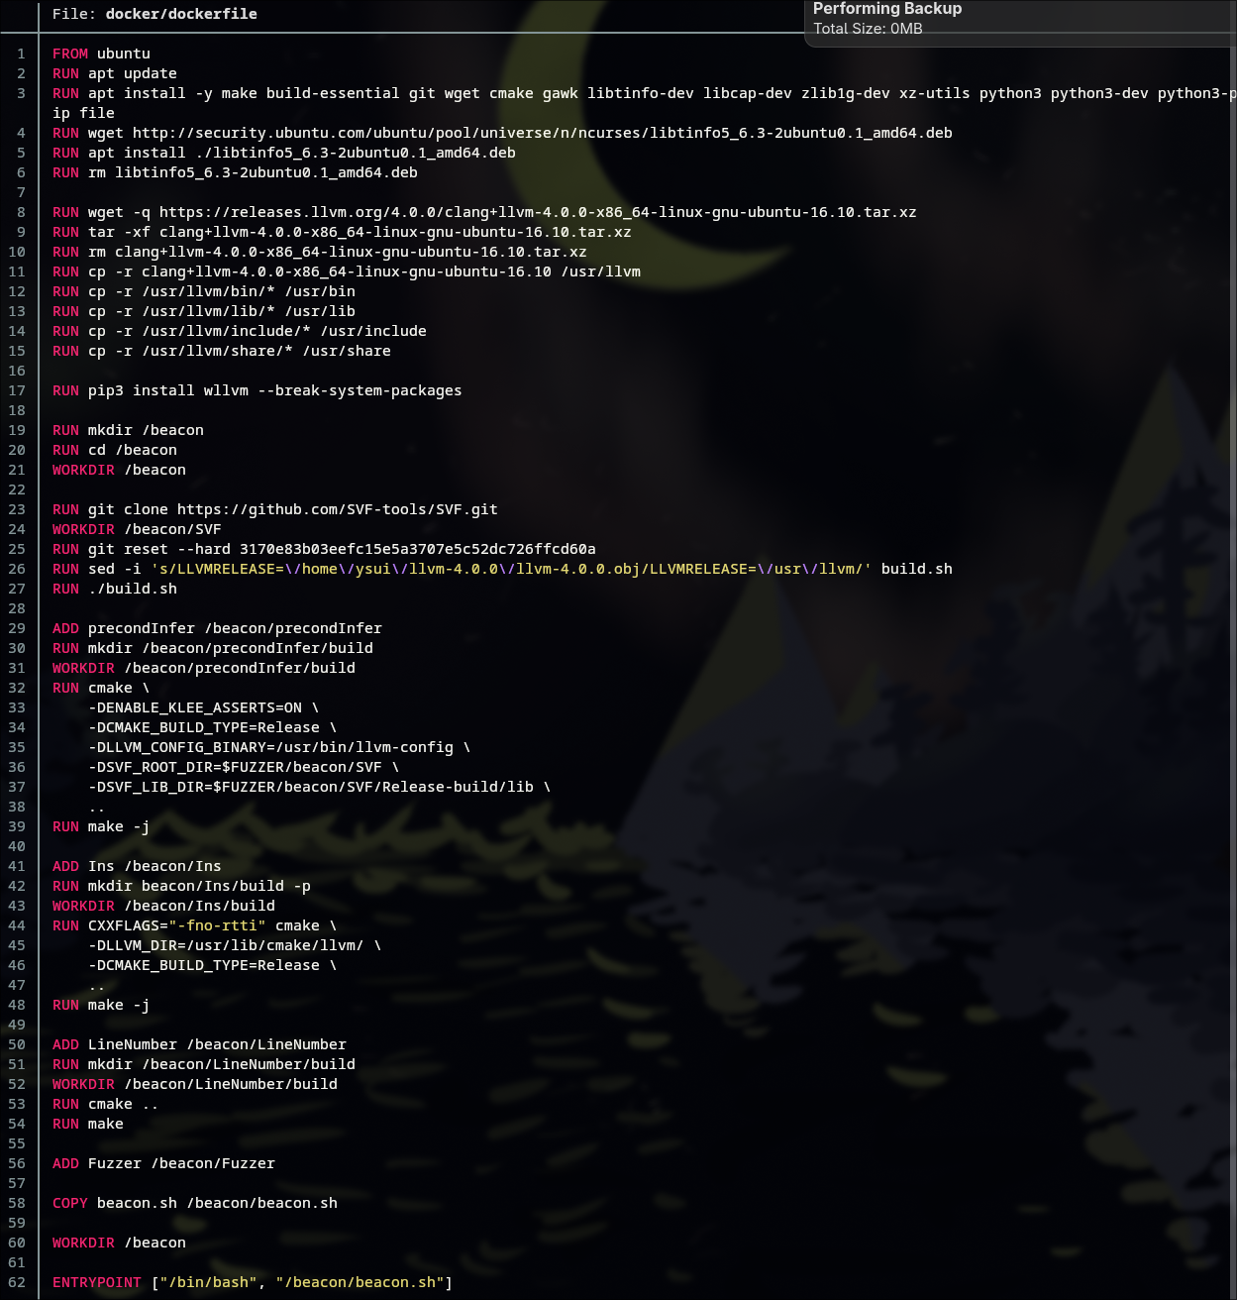
Dockerfile
The dockerfile on the left is out container
You can find the container on dockerhub at patrickelser/beacon

Slide 23
Dockerfile
The dockerfile on the left is out container
You can find the container on dockerhub at patrickelser/beacon
First, dependent packages and versions are installed
LLVM 4.0.0
C++ 17

Slide 24
Dockerfile
The dockerfile on the left is out container
You can find the container on dockerhub at patrickelser/beacon
Second, BEACON is build
SVF is also pulled and built

Slide 25
Dockerfile
The dockerfile on the left is out container
You can find the container on dockerhub at patrickelser/beacon
Finally, our tooling as added
LineNumber finds the //?BEACON comments
beacon.sh is our script that automates the build process

Slide 26
Contribution
Our contributions so far
Make a docker container with BEACON and necessary tools
Create a script to automate the steps of compilation and beacon instrumentation

Slide 27
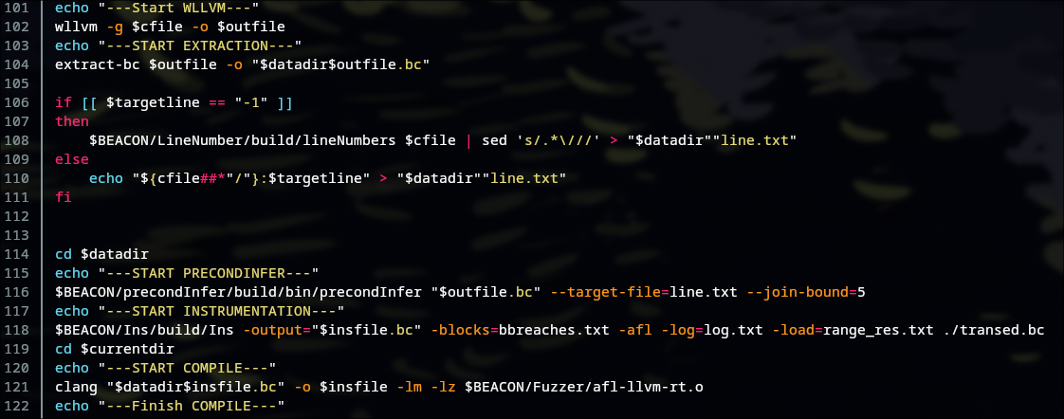
beacon.sh

Slide 28
Contribution
Our contributions so far
Make a docker container with BEACON and necessary tools
Create a script to automate the steps of compilation and beacon instrumentation
Integrate into a Gitlab CI/CD pipeline

Slide 29
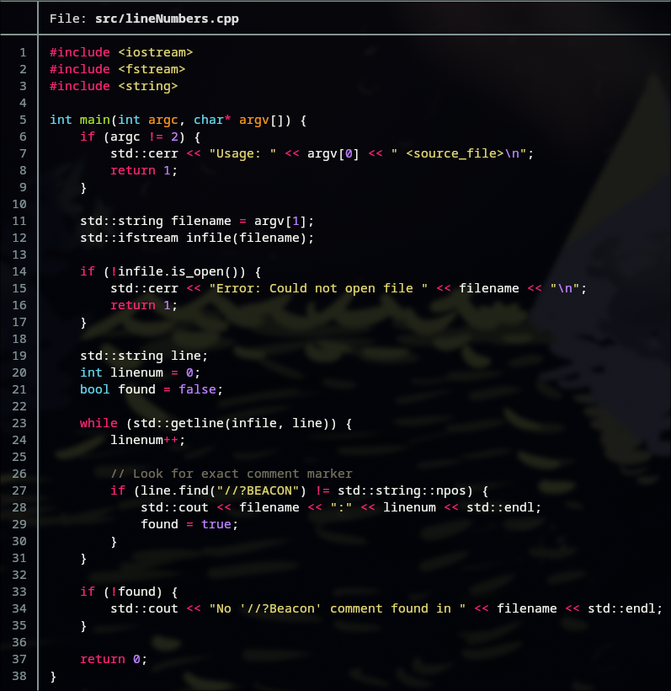
Contribution
Our contributions so far
Make a docker container with BEACON and necessary tools
Create a script to automate the steps of compilation and beacon instrumentation
Integrate into a Gitlab CI/CD pipeline
Create a program that searches for the target line comment and feeds it to BEACON

Slide 30
Gitlab CI/CD
Live Demo!

Slide 31
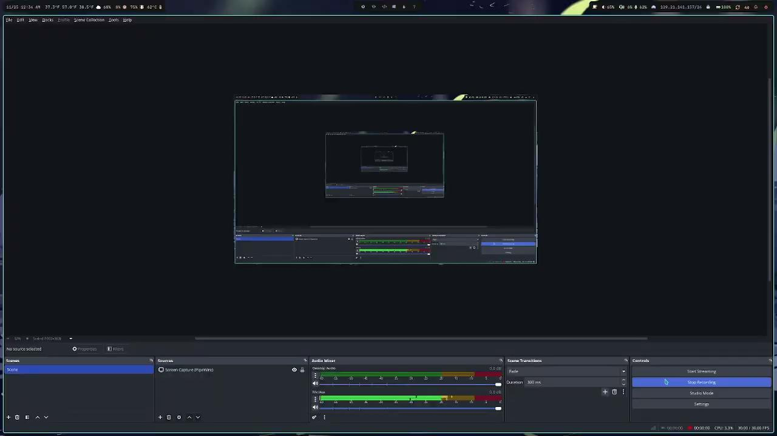
Video Backup Plan

Slide 32
Left To Do
Integrate with CMake
The current solution only works for single-file projects
BEACON+CMake is working on the command line, just need to automate
Implement Fuzzing Stage
Currently, we only instrument the binaries, and do not fuzz
BEACON just uses AFL for fuzzing, which is well documented
May require a switch to my personal self-hosted Gitlab for cost reasons

Slide 33
Thank You!
Questions?

Slide 34
Methodology Details:
Simple language model: Programs reduced to assignments, assumes, and non-deterministic branches.
Predicate transformers: Standard approach to compute weakest preconditions.
JoinPaths function: Handles merging of interval abstractions while respecting bounded disjunction.
Instrumentation: Precondition checks inserted post variable definitions or at unreachable branches.

Slide 35
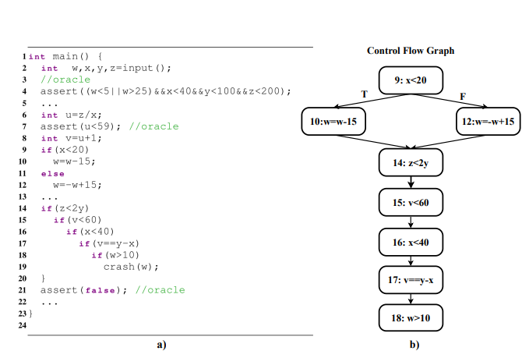
Backward Interval Analysis

Slide 36
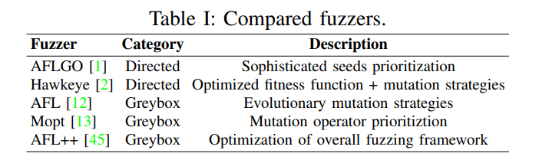
Evaluation
AFLGo [1] and Hawkeye [2] are two recent directed grey-box fuzzers that prioritize inputs so that inputs closer to the target code can be executed in a high priority.

Slide 37
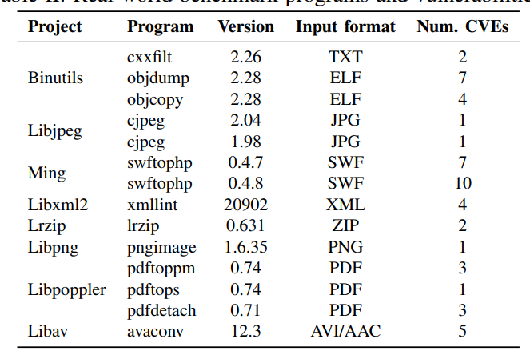
Evaluation
Benchmarks: 51 vulnerabilities across 14 real-world programs
Configuration: Threshold for bounded disjunction = 5; experiments run 10 times each, seeds provided by AFLGo in their Github repository with a time budget of 120 hours. All experiments were conducted on an Intel Xeon(R) computer with an E5-1620 v3 CPU and 64GB of memory running Ubuntu 16.04 LTS

Slide 38
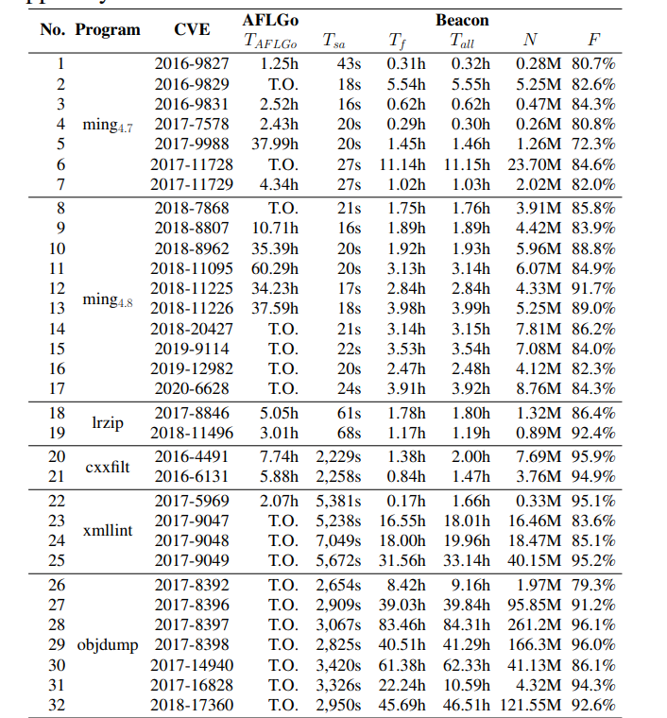
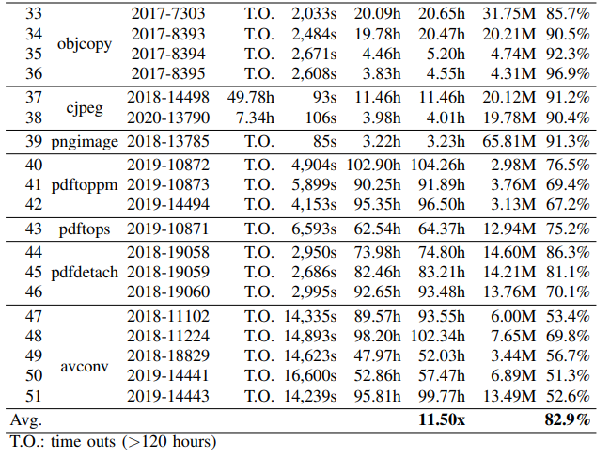
Results

Slide 39
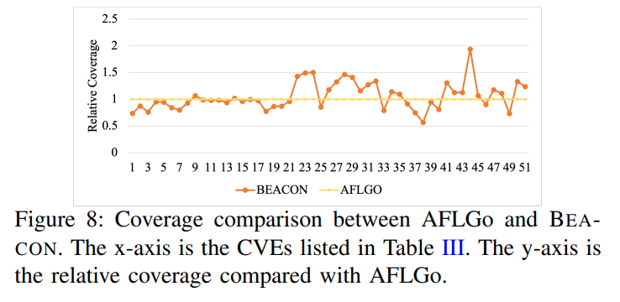
Results
AFLGo fails on 34/51 CVEs
BEACON finds all 51, 23 within 5 hours, 33 in 24 hours (including static analysis).
Speedup: 1.2× – 68.5×, average 11.5× .
Over 80% of paths pruned at runtime.
Precondition analysis in BEACON is at most 5 hours.
BEACON uncovered:
14 incomplete fixes.
8 additional bugs.
10 new CVEs assigned.
BEACON needs less coverage because it avoids infeasible paths (91.2% on average) .
Notes:
Precondition analysis in BEACON is at most 5 hours, and, in many cases, it can complete in only a few minutes
BEACON detected 3, 9, and 2 incomplete patches in Binutils, Ming, and Lrzip, respectively, and 8 additional bugs, whereas AFLGo only detected 6 incomplete patches.

Slide 40
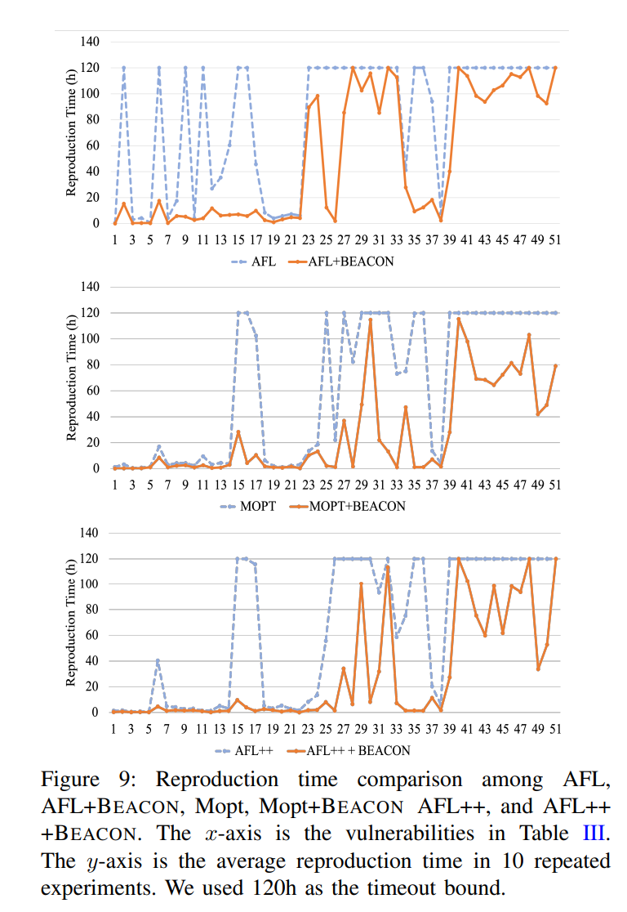
Compared to AFL, AFL++, and Mopt:
Fuzzer | Base | With BEACON | Speedup
AFL | slow | much faster | 6.3×
AFL++ | fast | even faster | 11.86×
MOpt | fast | even faster | 10.92×

Slide 41
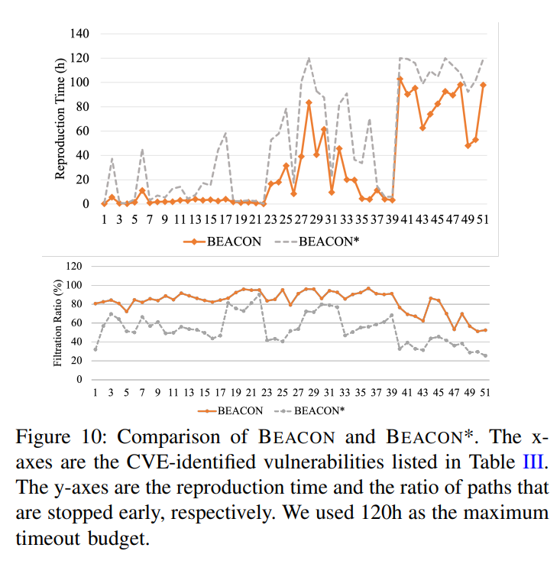
BEACON vs Naive BEACON
BEACON* disables the core static analysis features.
Results:
BEACON is 1.1–18.4× faster
BEACON prunes 29% more paths
BEACON* cannot reproduce some CVEs at all
This validates the impact of:
Backward interval analysis
Relation tracking
Bounded disjunction

Slide 42
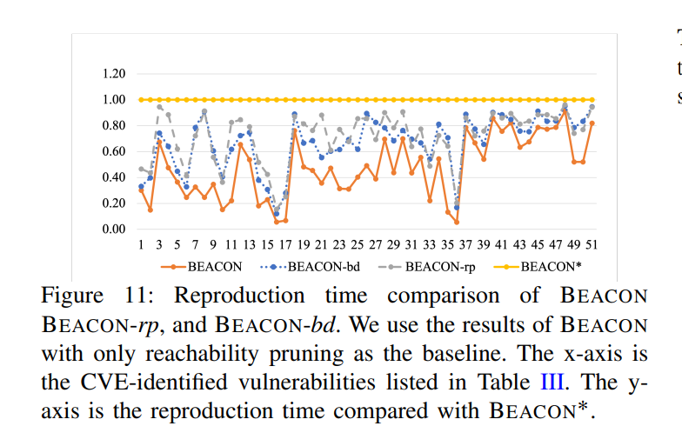
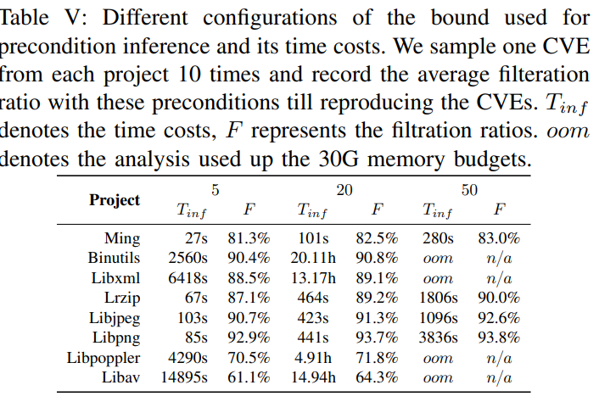
Impact of Relation Preservation, Bounded Disjunction and Threshold
BEACON-rp, disabled relation preservation.
BEACON-bd, disabled bounded disjunction.
Results:
BEACON full version performs 1.05–5.34× better than versions missing these optimizations.
Threshold analysis shows:
τ > 5 improves filtration but explodes cost
τ = 5 is optimal
(as found in the paper)

Slide 43
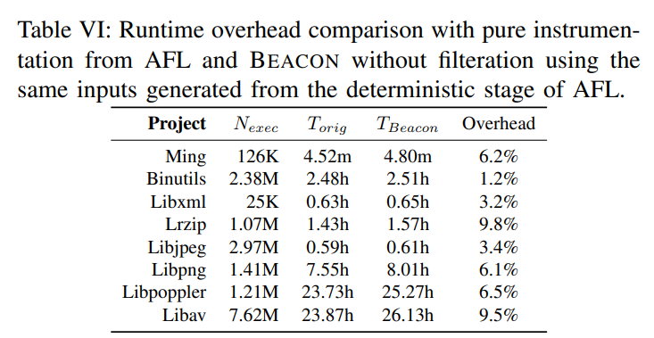
Instrumentation Overhead
To evaluate the overhead at runtime, same inputs are run against 2 versions of every benchmark program.
One is vanilla and one is instrumented by BEACON.
Max overhead: 9.8%
Average overhead: 5.7%
Critical point:
The overhead is tiny compared to the massive reduction in fuzzing time enabled by pruning.
N_{exec} =Number of executions
T_{orig} =Original time cost
T_{beacon} =Time cost after instrumentation

